Slide 1
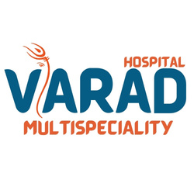

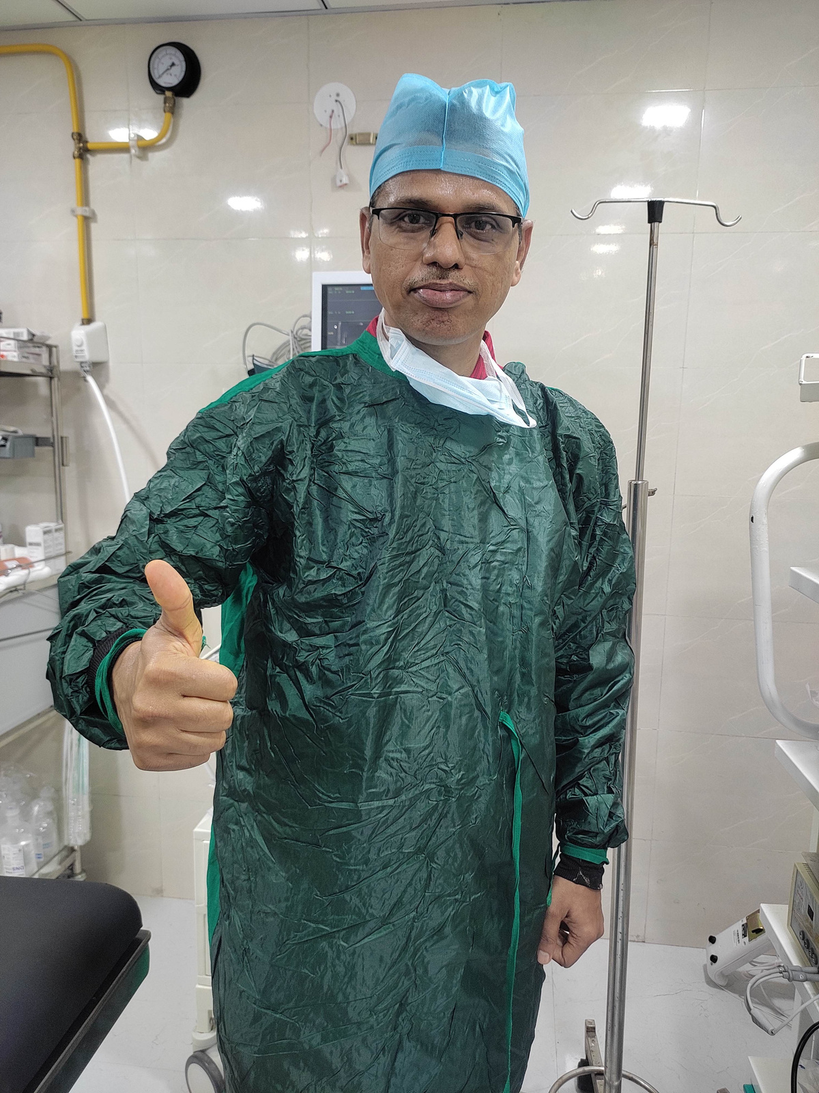
VARAD MULTISPECIALITY HOSPITAL, PUNAWALE
CHOLECYSTECTOMY
Surgery to Remove Gallbladder
Prepared by -
Dr. Vinayak Kshirsagar
General Surgeon (23+ Years of experience)
varadhospital.in

Slide 2
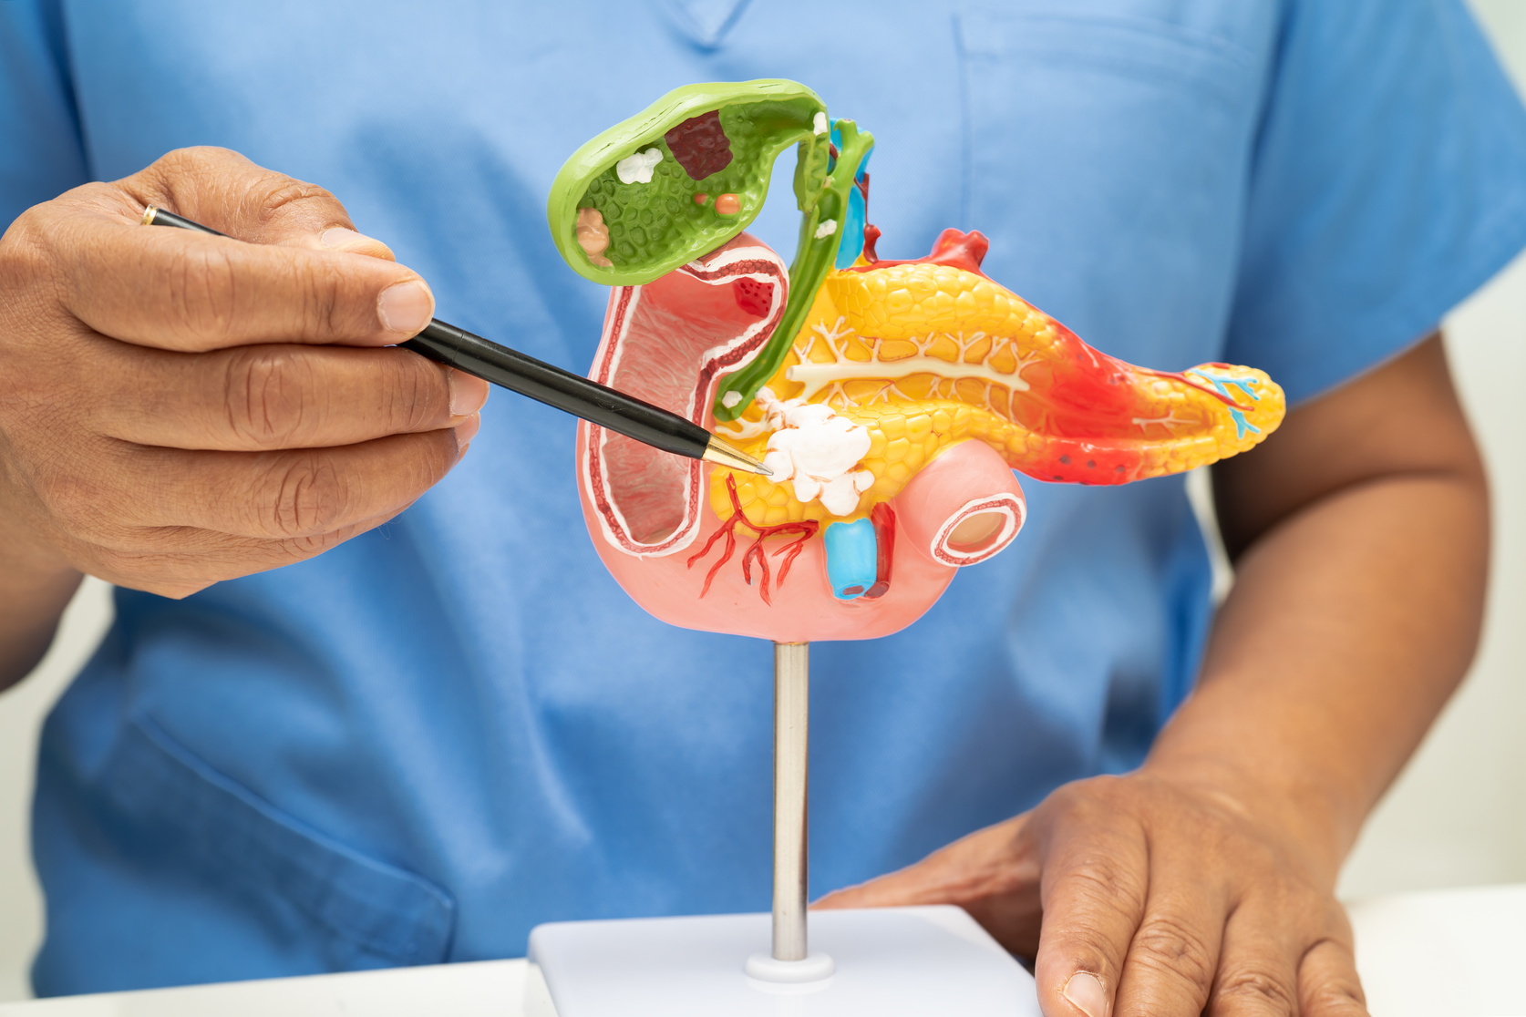
What is Cholecystectomy?
Cholecystectomy is the surgical removal of the gallbladder
It is commonly performed to treat gallstones, gallbladder inflammation, or infection
There are different surgical approaches depending on the case severity.

Slide 3
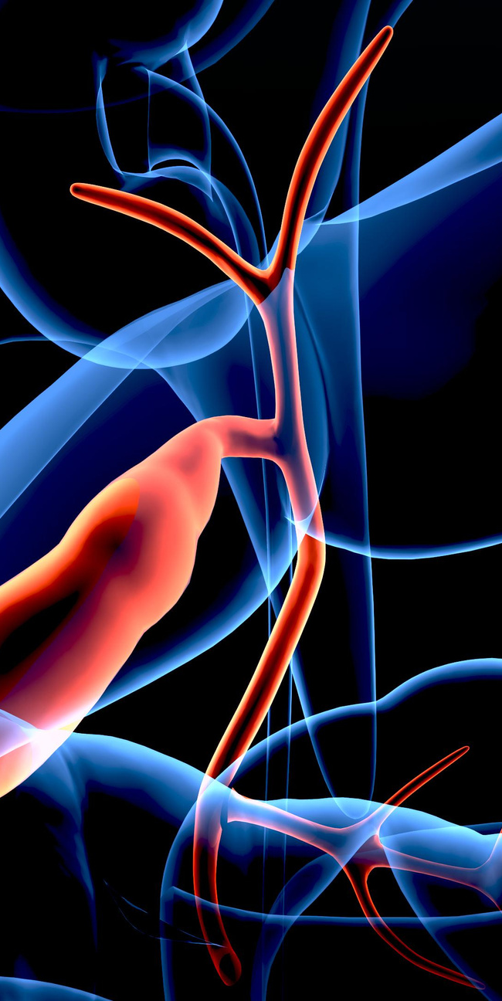
Types of Cholecystectomy
  Laparoscopic Cholecystectomy – Minimally invasive, most common.
  Open Cholecystectomy – Traditional surgery via larger incision.
  Robotic Cholecystectomy – Uses robotic arms for precision
  Subtotal Cholecystectomy – Partial removal of gallbladder
  Radical Cholecystectomy – Performed for gallbladder cancer

Slide 4


4 Port Laparoscopic Cholecystectomy
  Involves 4 small incisions for camera and instruments.
  Minimally invasive with faster recovery.
  Most preferred method for symptomatic gallstones.
  Performed under general anesthesia
Standard Laparoscopic Technique

Slide 5
Laparoscopic Cholecystectomy
  Less pain and shorter hospital stay than open surgery.
  Quick recovery (within 1-2 weeks).
  Rare complications and minimal scarring.
  Suitable for most gallstone cases

Slide 6
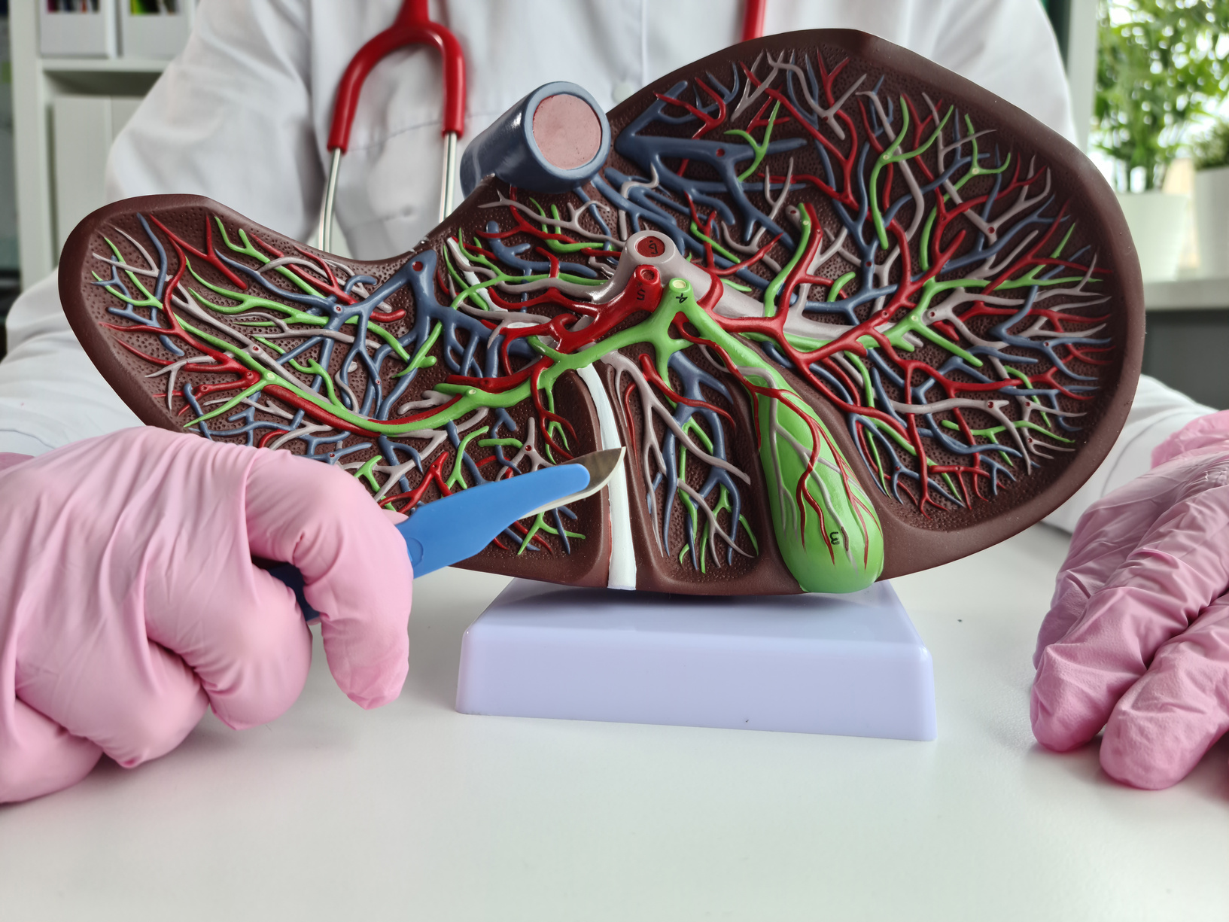
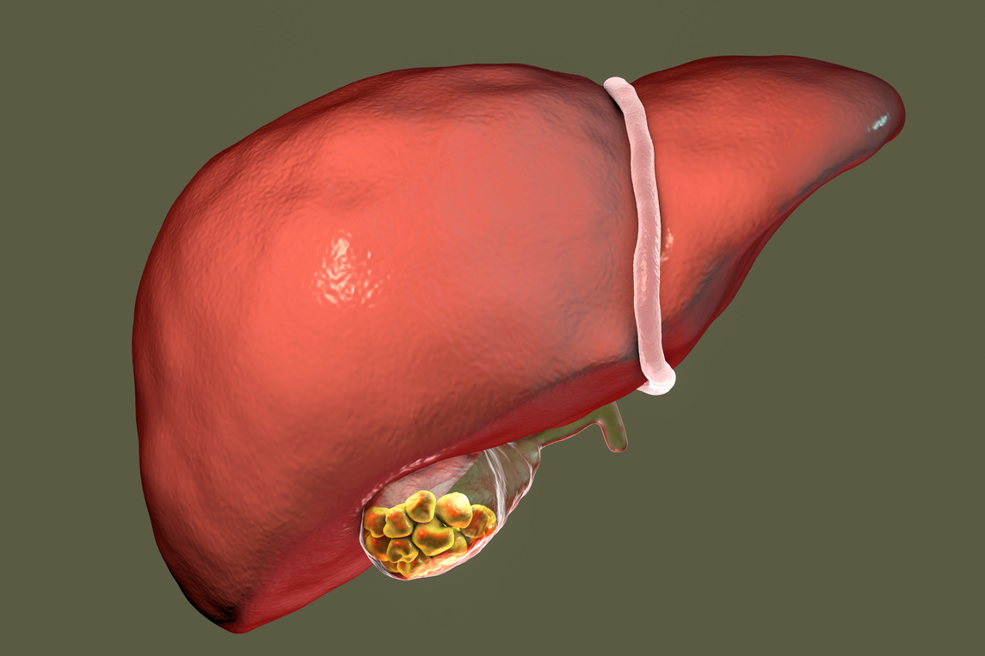
Open Cholecystectomy
  Required when laparoscopic surgery is not possible.
  Larger incision under the right ribcage.
  Longer hospital stay and recovery time (up to 6 weeks).
  Used in complicated cases like infection or large stones.

Slide 7
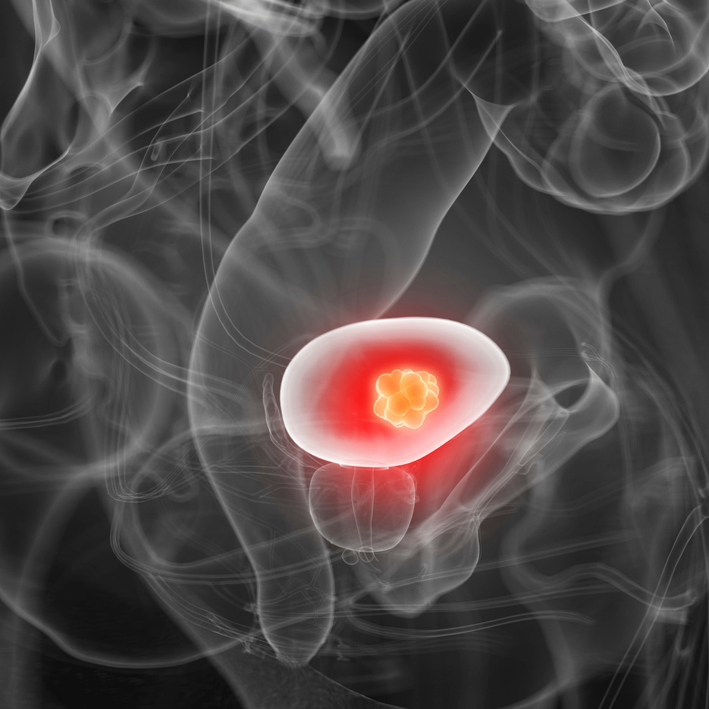
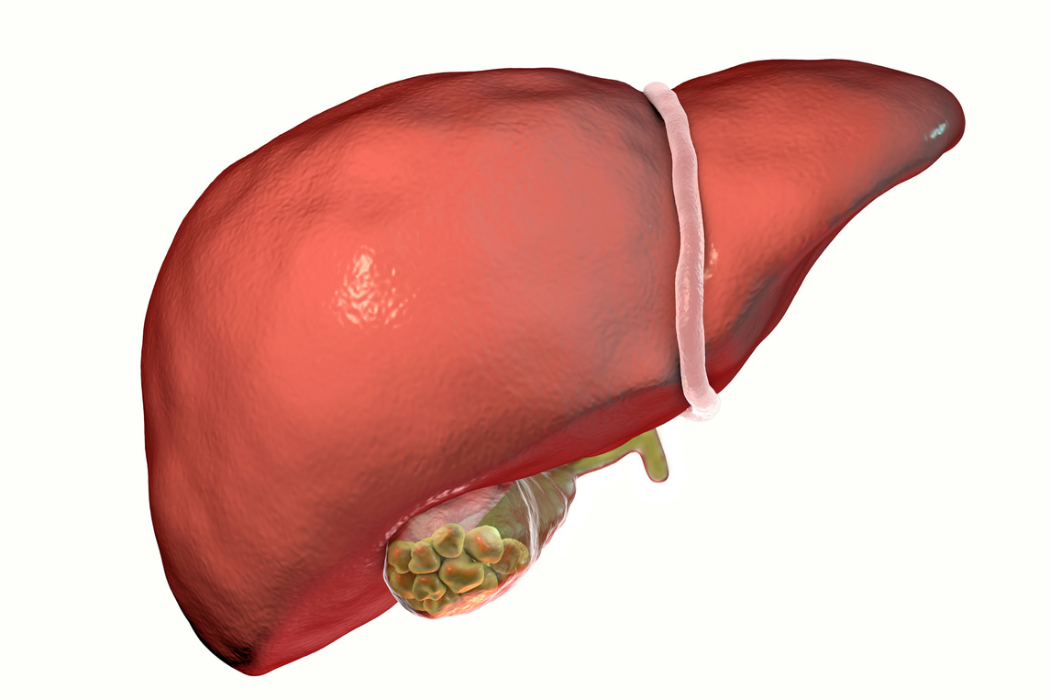
Radical Cholecystectomy
  Involves removal of gallbladder, part of liver, and lymph nodes.
  Performed when gallbladder cancer is diagnosed or suspected.
  Requires specialized surgical expertise.
  Often followed by chemotherapy or radiation

Slide 8


Complications of Laparoscopic Cholecystectomy
  Bleeding or infection at incision sites.
  Bile duct injury or leakage.
  Injury to nearby organs (rare).
  Postcholecystectomy syndrome (abdominal pain, indigestion).
  Blood clots or anesthesia-related issues

Slide 9
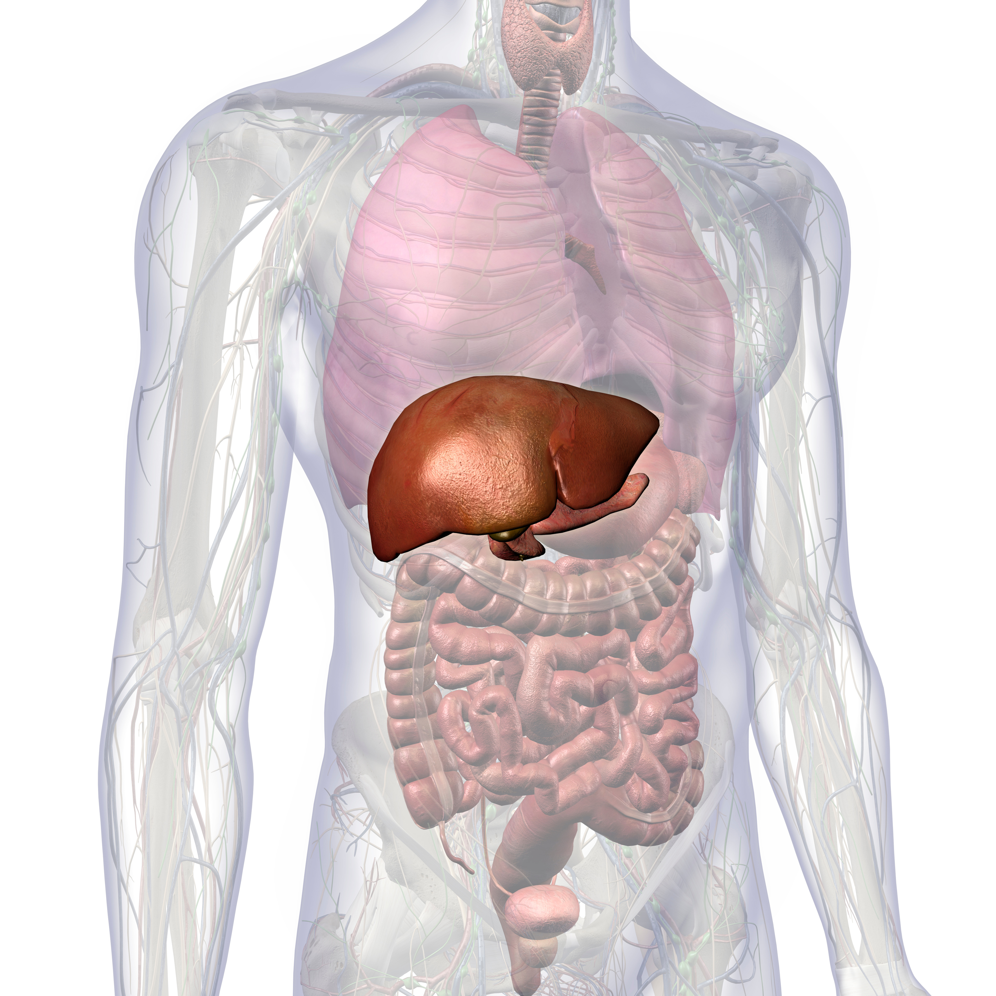
Robotic Cholecystectomy
  Performed using a robotic-assisted system.
  Provides greater precision, 3D view, and flexible movement.
  Less invasive and quicker recovery.
  Ideal for complex or obese patients.

Slide 10

Subtotal Cholecystectomy
  Done when complete removal is unsafe.
  Used in cases with severe inflammation or adhesions.
  Reduces risk of bile duct injury.
  May lead to recurrent symptoms in rare cases

Slide 11

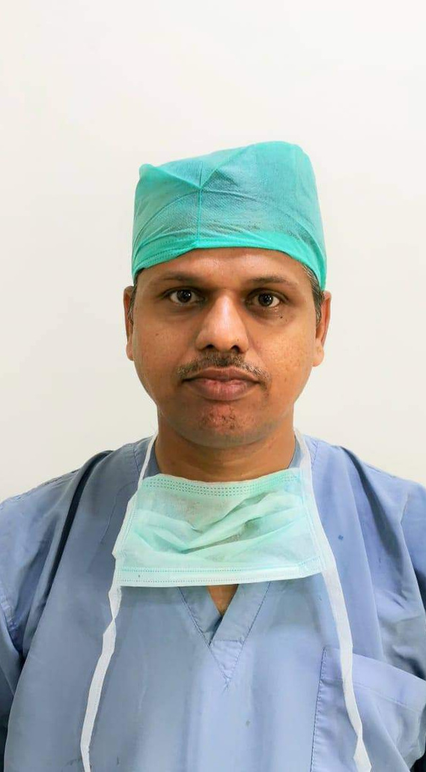

Dr. Vinayak Kshirsagar
Website : www.varadhospital.in
Email : vmhpunawale@gmail.com
Address : Varad Multispeciality Hospital, Regal Lake Town, Office No. 4-9, Near Buddha Vihar, Sai Sagar Nagar, Tathawade Road, Punawale, Pimpri-Chinchwad, Pune – 411033
7070107065

Slide 12
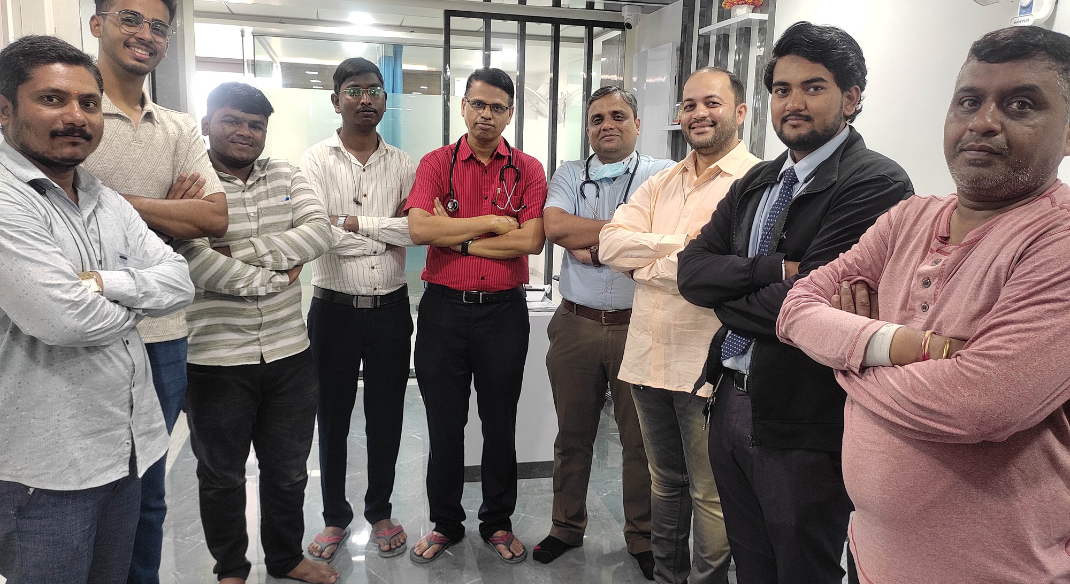
THANK YOU
VARAD MULTISPECIALITY HOSPITAL, PUNAWALE

